Slide 1


Intelligent Home Security System
Intrusion Detection using Ultrasonic Sensor with Automatic Door Control, Alarm Generation, Cloud Notification & Telegram Alerts
STM32 + ESP32 + Firebase + Telegram

Slide 2

Project Overview
Objective: Detect intruders using an Ultrasonic Sensor and secure the premises instantly.
•
Lock the door automatically using a Servo Motor.
•
Activate LED and Buzzer during an intrusion.
•
Send instant alerts through Telegram.
•
Store security events in Firebase Realtime Database.

Slide 3






System Architecture
1. Input & Processing
2. Local Output Action
3. Cloud & Connectivity
Upon detection, the STM32 triggers immediate local actions.
The HC-SR04 Ultrasonic Sensor detects physical presence.
Alert data is pushed via UART to the ESP32 WiFi Module.
Servo Motor locks the door, while the LED and Buzzer initiate a high-visibility alarm sequence.
Data flows directly into the STM32F446RE for real-time edge processing and logic evaluation.
The ESP32 communicates securely with Firebase Database and dispatches Telegram Bot alerts.

Slide 4

Complete Hardware Components
Component | Quantity | Primary Role
STM32F446RE | 1 | Main Controller for logic & actuator handling
ESP32 Dev Board | 1 | WiFi Communication & Cloud Integration
HC-SR04 Ultrasonic | 1 | Intrusion Detection (Proximity)
SG90 Servo Motor | 1 | Automated Door Lock Control
Active Buzzer & LED | 1 each | Local Alarm & Status Indication
Push Button | 1 | Manual System Reset / Override

Slide 5


STM32 Connections: Sensors & Actuators
HC-SR04 Sensor
SG90 Servo
Sensor Pin | STM32 Pin
VCC | 5V
GND | GND
TRIG | PB0
ECHO | PB1 (Voltage Divider Req.)
Servo Pin | STM32 Pin
VCC | External 5V
GND | GND
Signal | PA6

Slide 6



STM32 Connections: Alarms & Inputs
LED Status
Active Buzzer
Reset Button
Provides visual indication of the system's active alarm state.
Provides high-decibel auditory alert upon unauthorized entry.
Allows manual override or resetting the alarm state securely.
Anode (+): PC0 (w/ 220Ω Resistor)
Positive (+): PC1
Pin 1: PC2
Negative (-): GND
Cathode (-): GND
Pin 2: GND

Slide 7




ESP32 to STM32 UART Connection
STM32 Pin | ESP32 Pin
PA2 (TX) | GPIO16 (RX2)
PA3 (RX) | GPIO17 (TX2)
GND | GND
Important Notes
• Connect Common Ground across boards.
• Add a 1kΩ resistor between STM32 TX & ESP32 RX to protect 3.3V logic.
• Standard Baud Rate: 115200

Slide 8
System Workflow: Detection Phase
2. STM32 Init
4. Ultrasonic Scan
Core setup complete.
Object detected in range.
1. Power ON
3. Servo Locks
5. Threshold Check
System boots up.
Door secured automatically.
Is Distance < Threshold? (YES)

Slide 9
System Workflow: Alert Phase
2. UART Sent
STM32 pushes alert to ESP32.
4. Owner Alert
Push notification received.
1. Alarm Triggered
3. Cloud Update
5. Remote Reset
LED ON, Buzzer ON, Door Locked.
Telegram & Firebase notified.
Owner secures & unlocks via app.

Slide 10

ESP32 & STM32 Communication
UART Command Lexicon
STM32 UART Bridge ESP32 Firebase & Telegram
INTRUDER → Flags unauthorized entry
STATUS → Requests current system state
RESET → Turns off alarms & clears flags
LOCK → Engages servo lock mechanism
UNLOCK → Disengages servo lock

Slide 11






Firebase Setup: Initial Configuration
Step 1
Step 2
Step 3
Create a New Project.
Open Realtime Database.
Navigate to the official Firebase console:
Enable Google Analytics (Optional, but recommended for debugging). Click Continue.
Click "Create Database" and select Test Mode to allow ESP32 read/write access.
https://console.firebase.google.com

Slide 12







Firebase Setup: Integration Keys
Step 4
Step 5
Step 6
Copy the Database URL.
Go to Project Settings → Service Accounts.
Open the ESP32 Code in Arduino IDE.
Locate and copy the Database Secret / API Key.
Replace FIREBASE_HOST and API_KEY with your copied credentials.

Slide 13
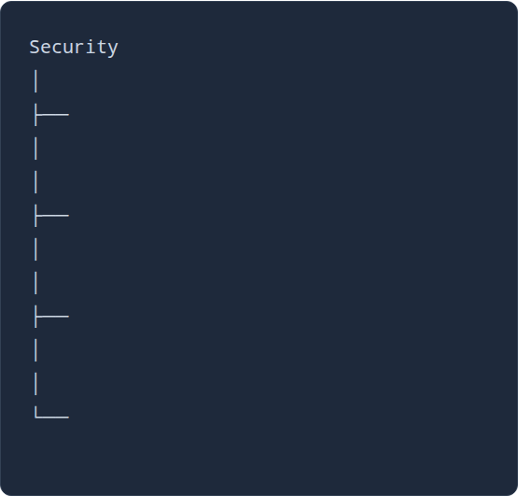

Firebase Data Structure
Status
"Locked"
Intruder
TRUE
Time
"10:30 PM"
Distance
"18 cm"

Slide 14


Telegram Bot Setup: Creation
Steps 1 & 2: Initiation
Steps 3 & 4: Credentials
Step 1: Open the Telegram app and search for the official @BotFather.
Step 3: Enter a friendly Bot Name, followed by a unique Bot Username.
Step 2: Type the command /newbot to initiate the creation process.
Step 4: BotFather will generate an HTTP API Token (BOT TOKEN). Copy and secure this token.

Slide 15



Telegram Bot Setup: Activation
Steps 5 & 6
Steps 7 & 8
Step 9
Step 5: Search your newly created Bot in Telegram and click START.
Step 7: Send "Hello" to your bot in the app. Refresh the browser page.
Integration: Open your ESP32 Code.
Paste the copied values into the BOT_TOKEN and CHAT_ID macros to link the hardware.
Step 6: Open a browser to:
Step 8: In the JSON response, locate the chat object and find the id. Copy this CHAT_ID.
api.telegram.org/botYOUR_TOKEN/getUpdates

Slide 16

Telegram Commands
Command | System Action Triggered
/status | Returns the Current Status (Locked, Safe, Intrusion)
/reset | Remotely Resets Alarm and clears intrusion flags
/unlock | Manually Unlocks the Door via servo actuation
/lock | Manually Locks the Door securely
/arm | Arms Security mode & activates sensor polling

Slide 17


Complete Data Flow
Ultrasonic Sensor STM32 Controller Servo + LED + Buzzer Action UART Bridge ESP32 Module WiFi Router Firebase / Telegram API Owner Mobile Device

Slide 18
System Advantages
Automatic Intruder Detection Immediate sensing without blind spots.
Instant Telegram Alerts Notification delivered within milliseconds.
Cloud Monitoring Persistent logging in Firebase Database.
Remote Door Control App-based lock/unlock operations.
Real-Time Logging Track historical entry data accurately.
Low Cost Highly affordable off-the-shelf components.
Easy Installation Plug-and-play architectural design.
Expandable IoT System Open for additional smart sensors.

Slide 19






Future Enhancements
Biometrics
Surveillance
Custom App
Face Recognition & Fingerprint Authentication for secure local access.
ESP32-CAM module for live camera streaming inside the application.
Dedicated Mobile Application Dashboard for unified control.
Voice Control
RFID
AI Defense
Integration with Voice Assistants (Alexa/Google Home).
Secure RFID card or tag-based access control logging.
AI-Based Intrusion Detection to reduce false positive alerts.

Slide 20
Thank You!
Questions & Answers
STM32 + ESP32 + Firebase + Telegram

